Slide 1
Stock price prediction with optimized deep LSTM network with Adam optimizer.

Slide 2
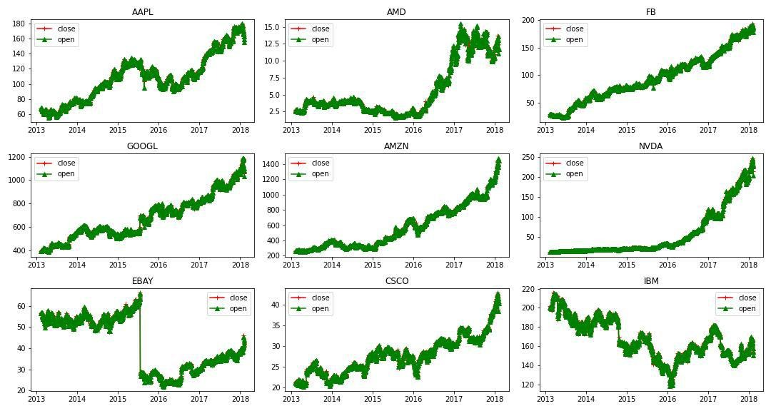
Analysing Close and Open prices for stocks of 9 different companies

Slide 3
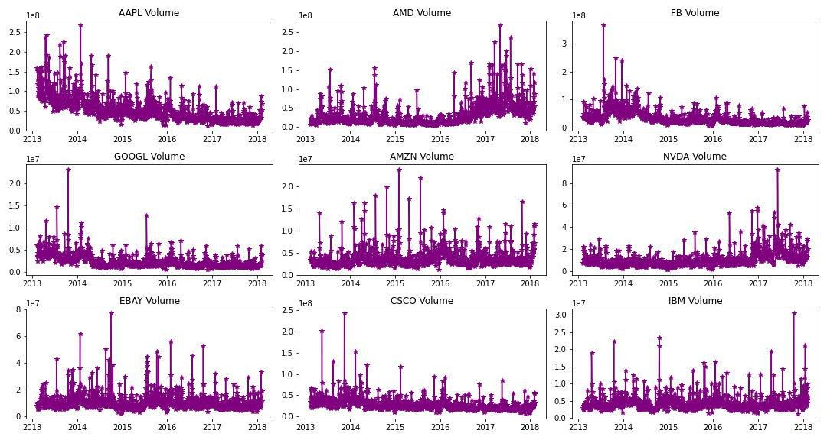
Analyzing volume for stocks of 9 different companies

Slide 4
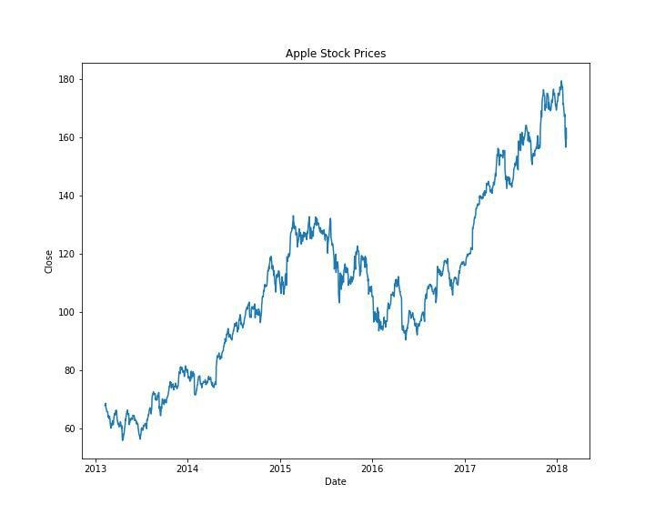
The overall trend in the prices of the Apple Stocks

Slide 5
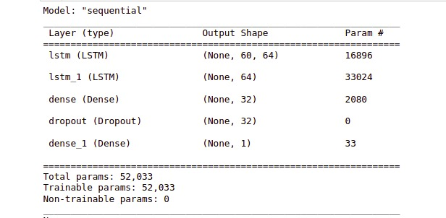
LSTM Stock Price Prediction Model Summary

Slide 6
Optimizing hyperparameters
We used Adam optimizer and MSE loss function
MSE = 46.0608
RMSE = 6.7868

Slide 7
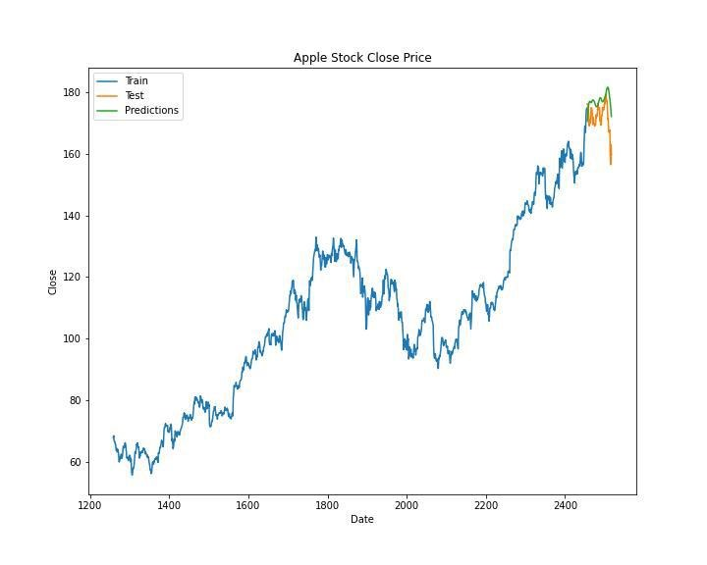
Visualising the final result

Slide 8
Comparison with previous work
Their research paper used backpropagation algorithm to optimize ANN for predicting future stock values by using past historical data of ACI pharmaceutical company, which include two inputs.
They tried to predict stock values for 8 days of November 2010.
The input past historical data is from 31-08-2010 to 30-09-2010.
The average error was 3.71%.
MSE = 230.5487

Slide 9
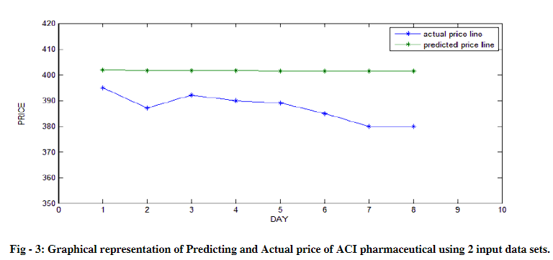

Slide 10
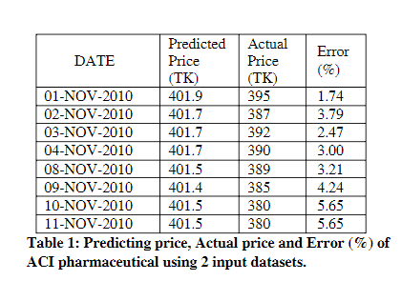

Slide 11
Reference
Price Prediction of Share Market Using Artificial Neural Network 'ANN' (Zabir Haider Khan, 2011)

